Slide 1
Snapshots
INTRODUCTION
For student registration each term quickly and efficiently , but also do statistics on the students basic information . registration information, and payment information and give results of the analysis . the background of the subject is analysed in the paper firstly . and the technologies used in the development are introduced . Then the implementation of the system is given in detail . The upgrade and expansion system for universities(SRSU)as a kind of management information system can not only record the information paper

Slide 2
ADVANTAGES
with student result management system , teachers , professors , and staff can create result analysis reports
Gradebook Management.
Exam Timetable Management.
Records marks and result on a single database.
Add & manage students and Declare Results.
Allot seat to students in exam halls.
Integrate-able with fee management
Create exams and tests online
Generate printouts of examination and test report instantly
Send/publish results to parents and students online
Record and search details of every exam/test, students wise/course wise
Admission card/ Hall ticket Generation
Calculate scores , percentages and grades

Slide 3
DISADVANTAGES
The student result management system is prone to hacks
Administration cannot edit or modify scores after the deadine
Extensive modules and features make it difficult for a utilize the application
Minor technical glitches and issues

Slide 4
SOFTWARE REQUIREMENTS
Platform : f ront end:
HTML:
Hypertext markup language , is the standard markup language for documents designed to be displayed in a web browser.it can be assisted by technologies such as CSS and scripting languages such as a java script
CSS:[cascading style sheet]
CSS is a style sheet language used for describing the presentation of a document witten in a markup language like HTML.CSS is a cornerstone technology of the WWW. HTML and java script
Back end:
My SQL:
My sql is an open source relation database management system based on SQL it is part of the popular LAMP platform consisting of uinux , apoache , my sql and php.
PHP:
PHP is a server-side scripting language that is used to develop static webserver . PHP stands for hypertext pre-processor . That earlier if stood for personal home page . PHP scripts can only be interpreled an a server that has PHP instalied.
Operting system- windows 11.

Slide 5
Hardware requirements
RAM -2GB or high end
Processor -Pentium dual core
Hard disk -120GB or high end
Input Device -keyboard , mouse
Monitor -17LCD

Slide 6
Er diagram

Slide 7
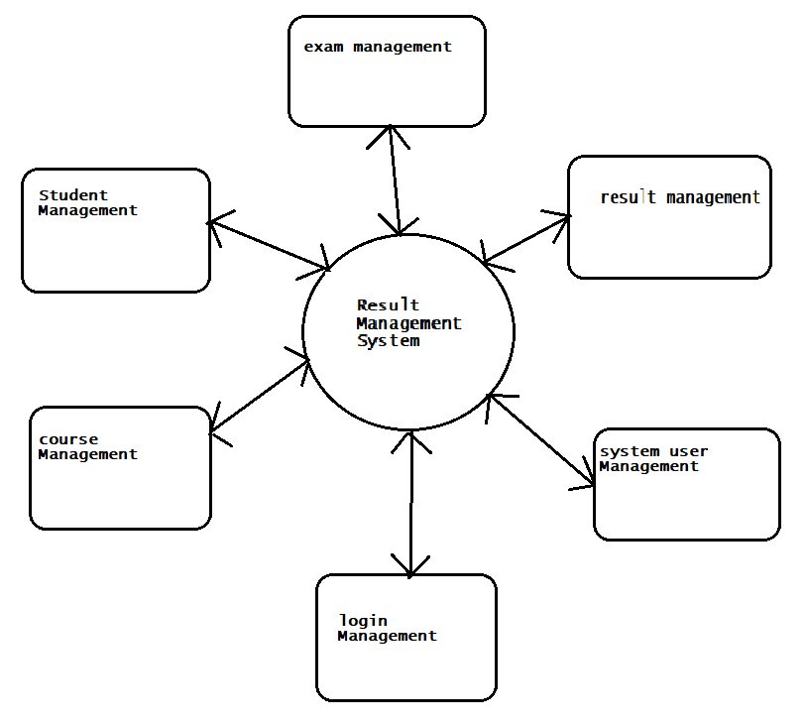
Data flow diagram

Slide 8
bibilography
Internet programming :- to know which and how the tags should we use.
Web Programming :- to know more details about the page.
Robert W . Websites :- programming the WWW.
Website References
:- get details of every DESIGN used in our project.

Slide 9
CONCLUSION
The goal of the system is achieved and difficulties are solved . The project is built such that is user friendly . Analysis of the scoring system it show by wish result of individual subject and final result also display grade wish.
Depending on its range of marks . The project can be easily used in college for college result . Analysis of student . It reduces time which required for manual calculation . This system helps to calculate result fast so it optimizes the manpower.

